Slide 1
Mixed signal Generator
박민지

Slide 2
목차
회로도
라이브러리-트리머
라이브러리-캐패시터, 저항
라이브러리-OPA196
PCB Design
문제점 및 개선 방안
펌웨어
HET IDE
Instructions
CCS Code
문제점 및 개선 방안
향후 일정
Reference

Slide 3
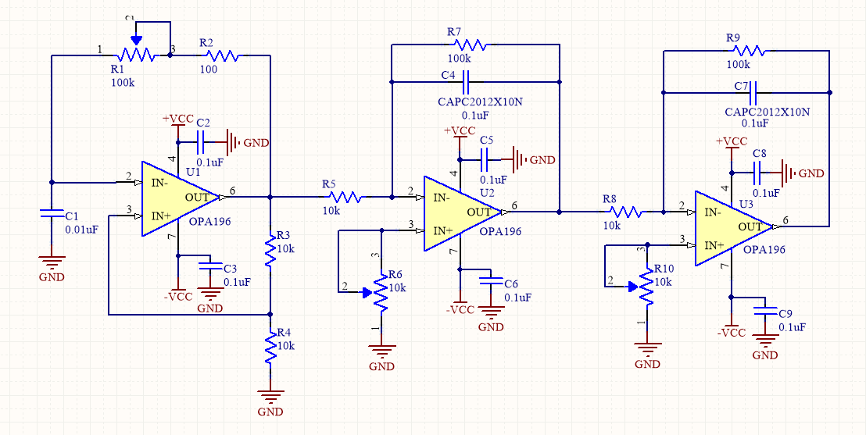
회로도
Altium Designer 16.1

Slide 4
Block Diagram
PWM
(Square Wave)
Integrater
(Triangle Wave)
LPF
(Sine Wave)

Slide 5
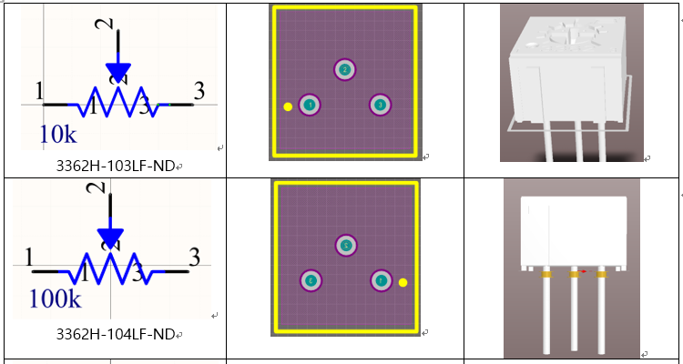
라이브러리 트리머

Slide 6
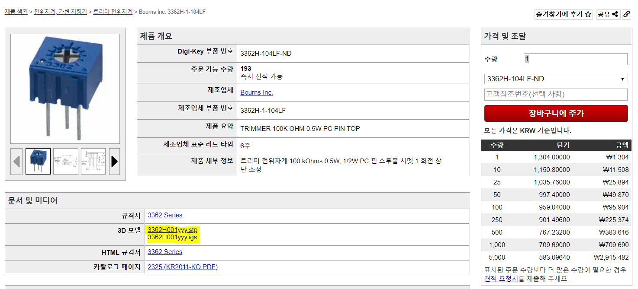
3D 모델 출처
https://www.digikey.kr/product-detail/ko/bourns-inc/3362H-1-104LF/3362H-104LF-ND/1088388

Slide 7
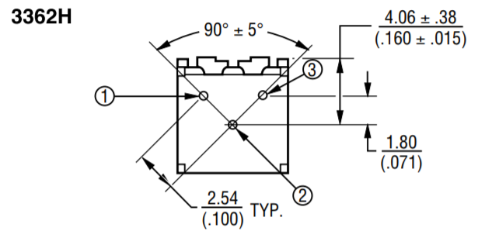
Footprint Size

Slide 8
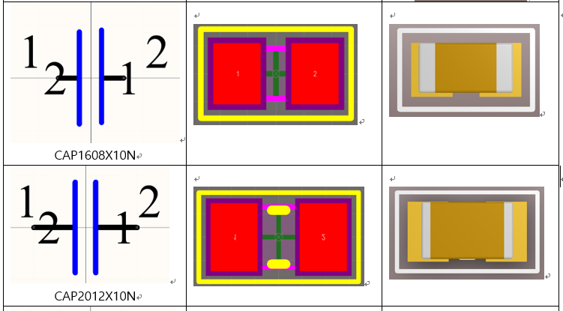
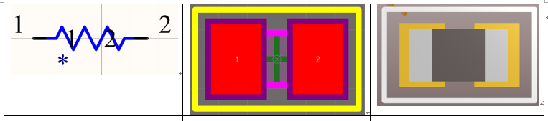
라이브러리 CAP, RES

Slide 9
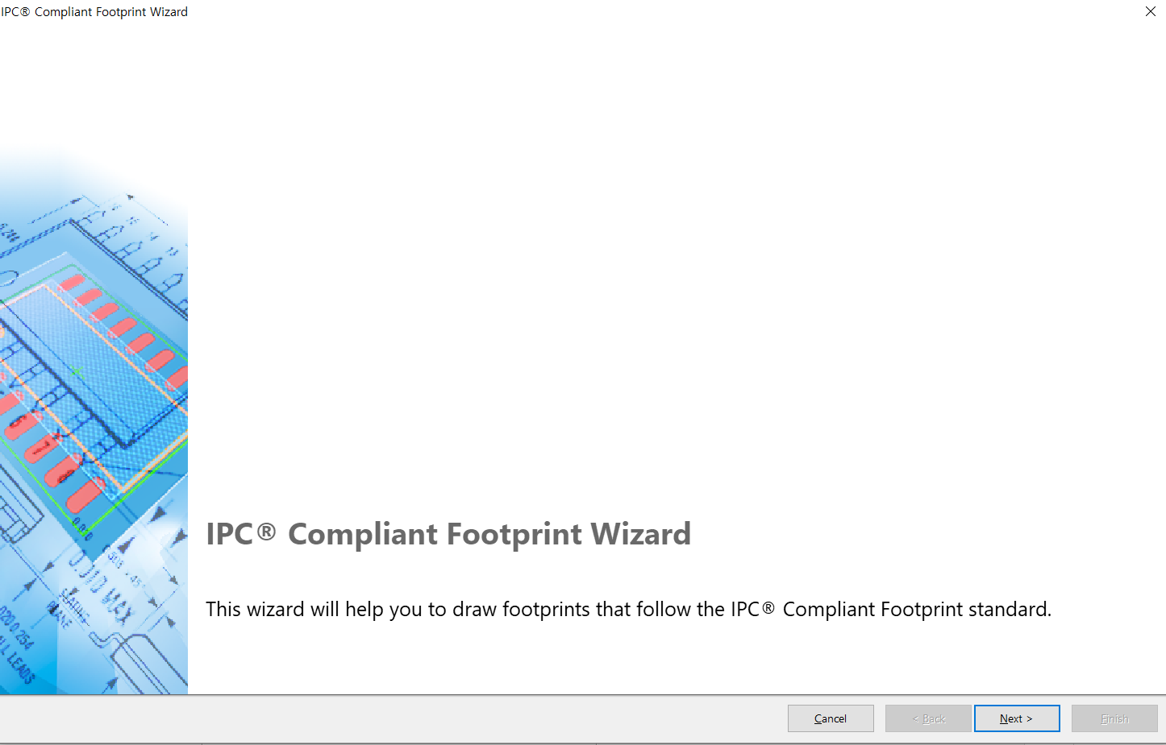
Tools -> IPC Compliant Footprint Wizard

Slide 10
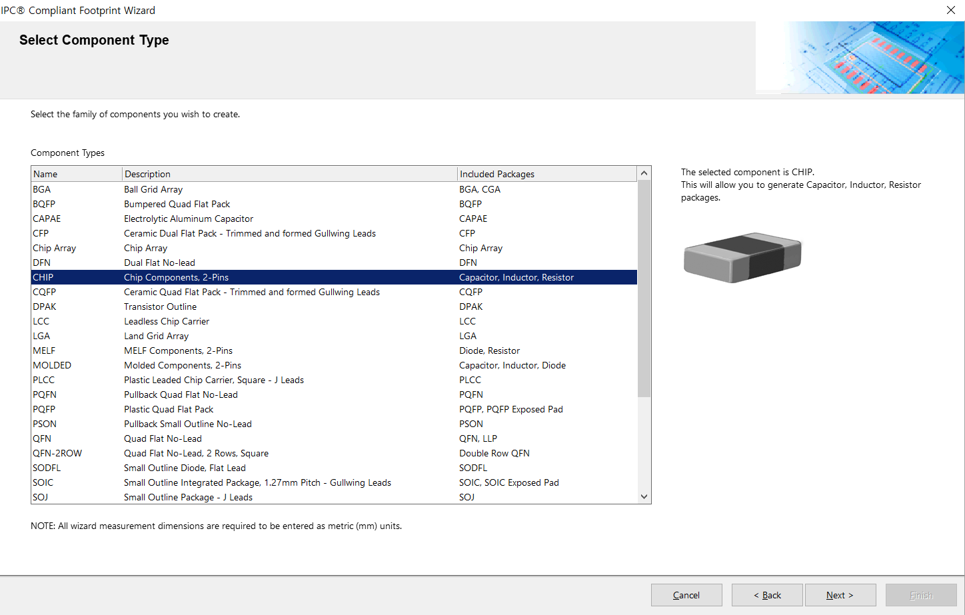
Chip 선택

Slide 11
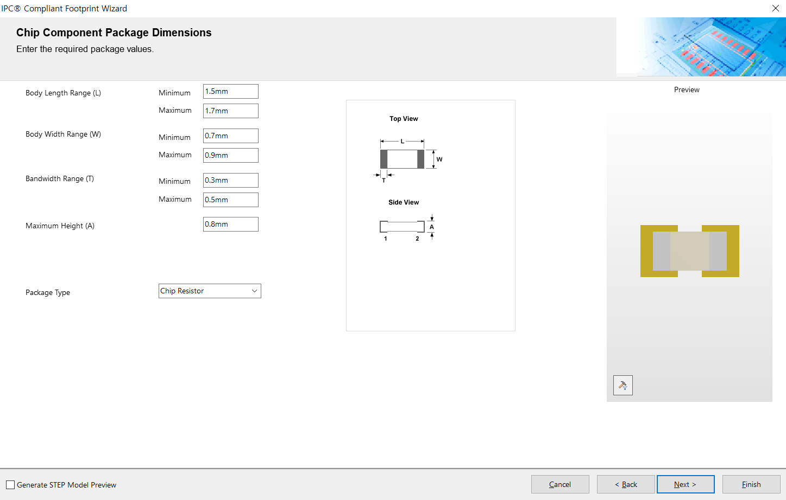
1608 기준으로

Slide 12
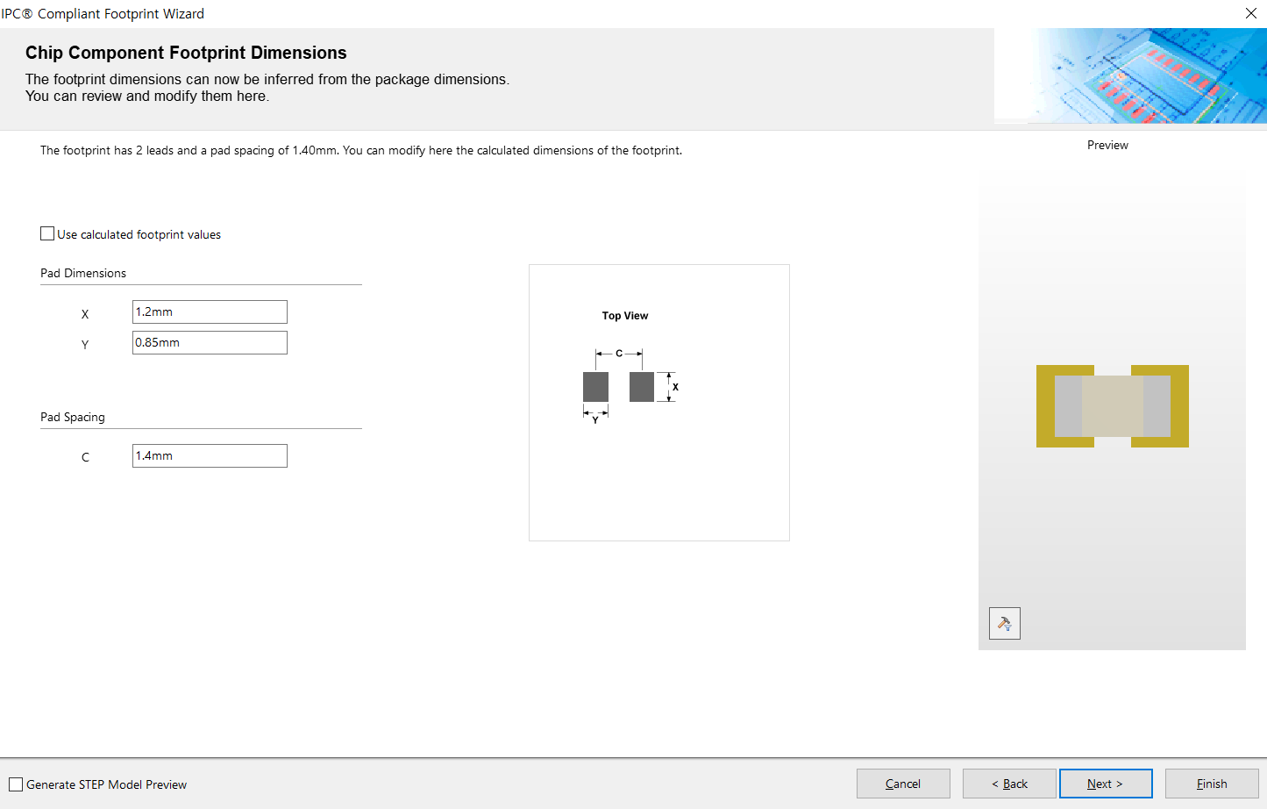
Next 계속 누른 후 Pad size 설정

Slide 13
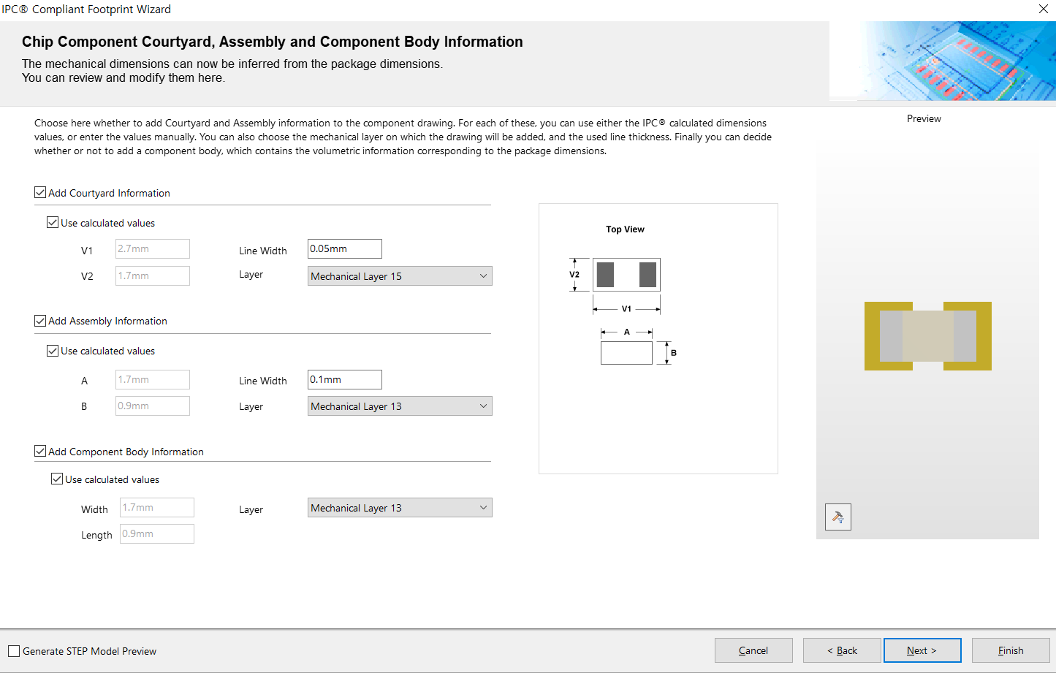
Silk screen size Assembly size 3d component

Slide 14
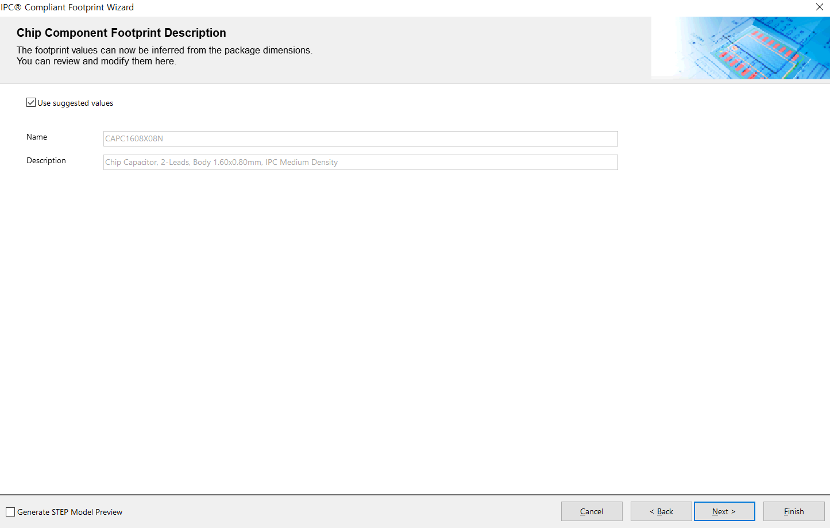
Component name Description

Slide 15
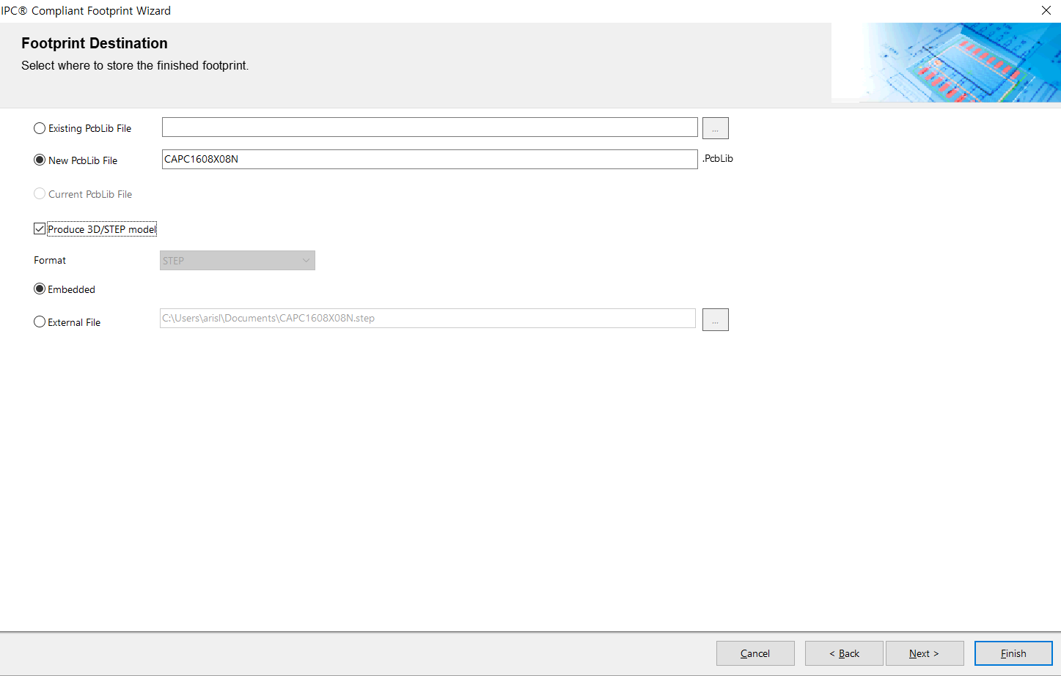
Library 위치 및 3D model 설정

Slide 16
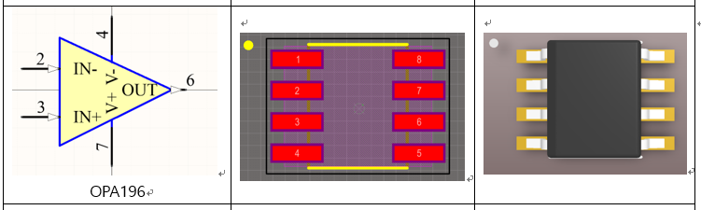
라이브러리 -OPA196

Slide 17
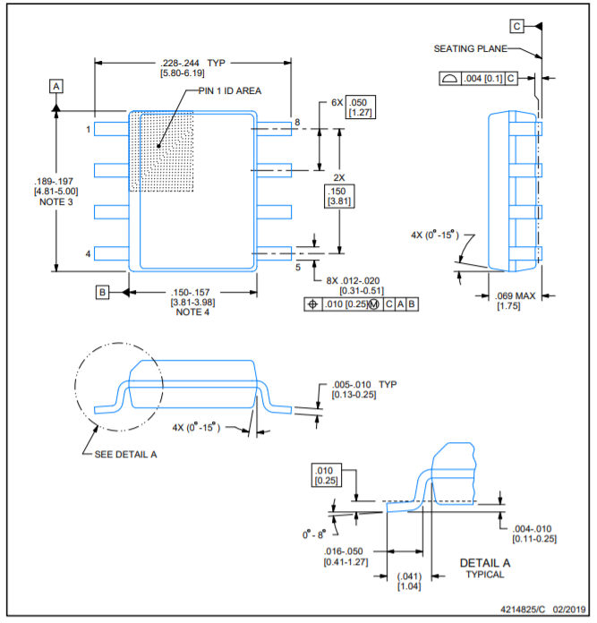
3D Model

Slide 18
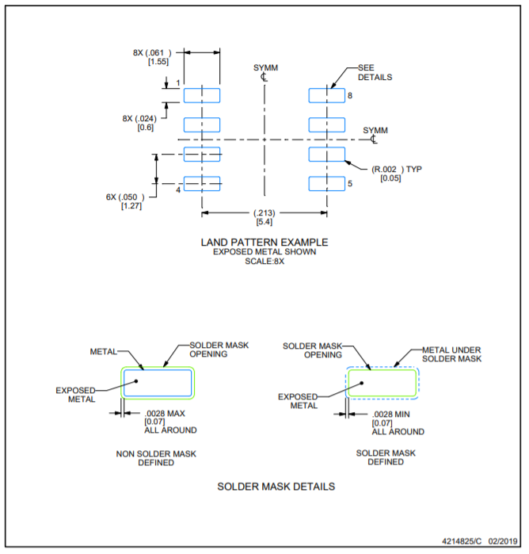
Footprint Layout

Slide 19
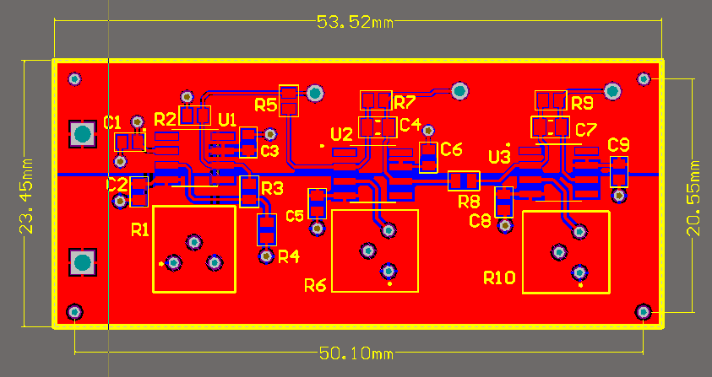
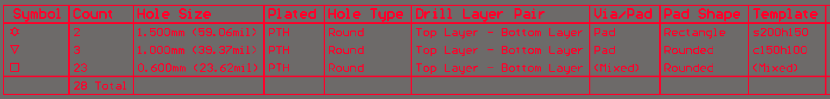
PCB

Slide 20
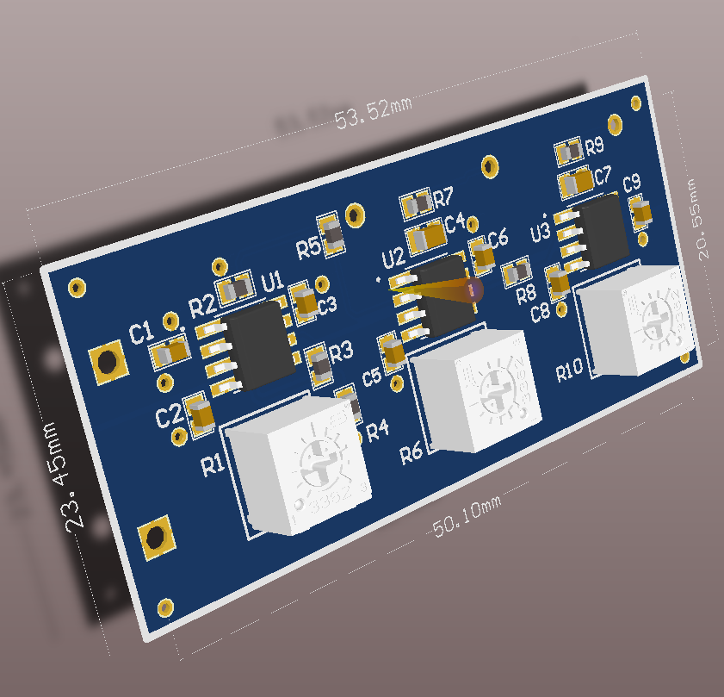
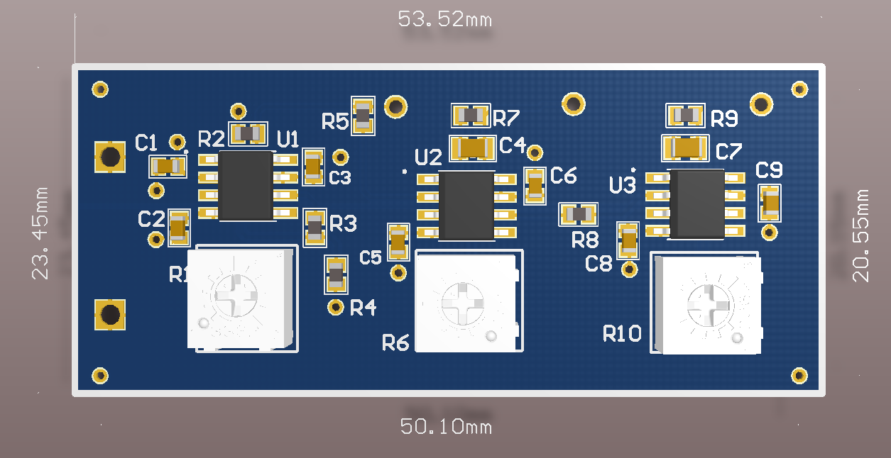

Slide 21
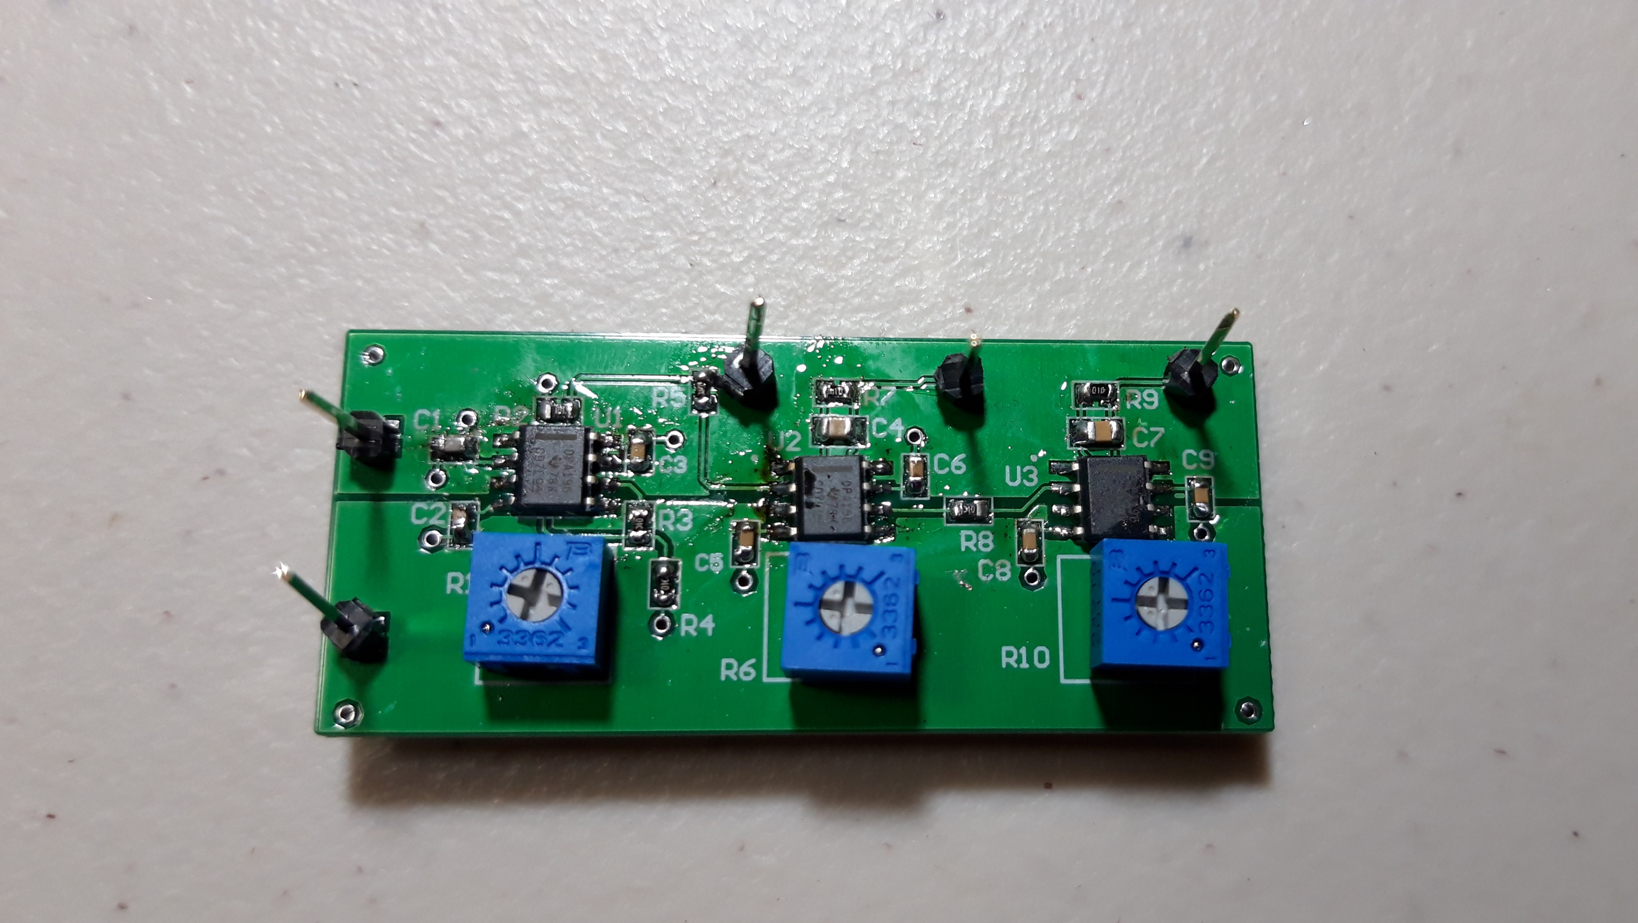

Slide 22
문제점 및 개선 방안
PWM part에서 피드백이 일어나지 않음
VCC와 –VCC에 5V 공급이 안됨
PCB Top Layer에서 VCC와 -VCC간의 간섭
Power plane 설정 시 간격 및 영역 조절
GND Via 확인

Slide 23
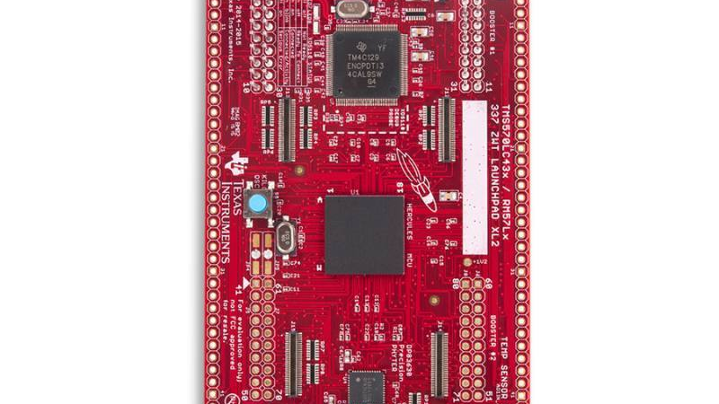
펌웨어
HET IDE
Instructions
CCS Code

Slide 24
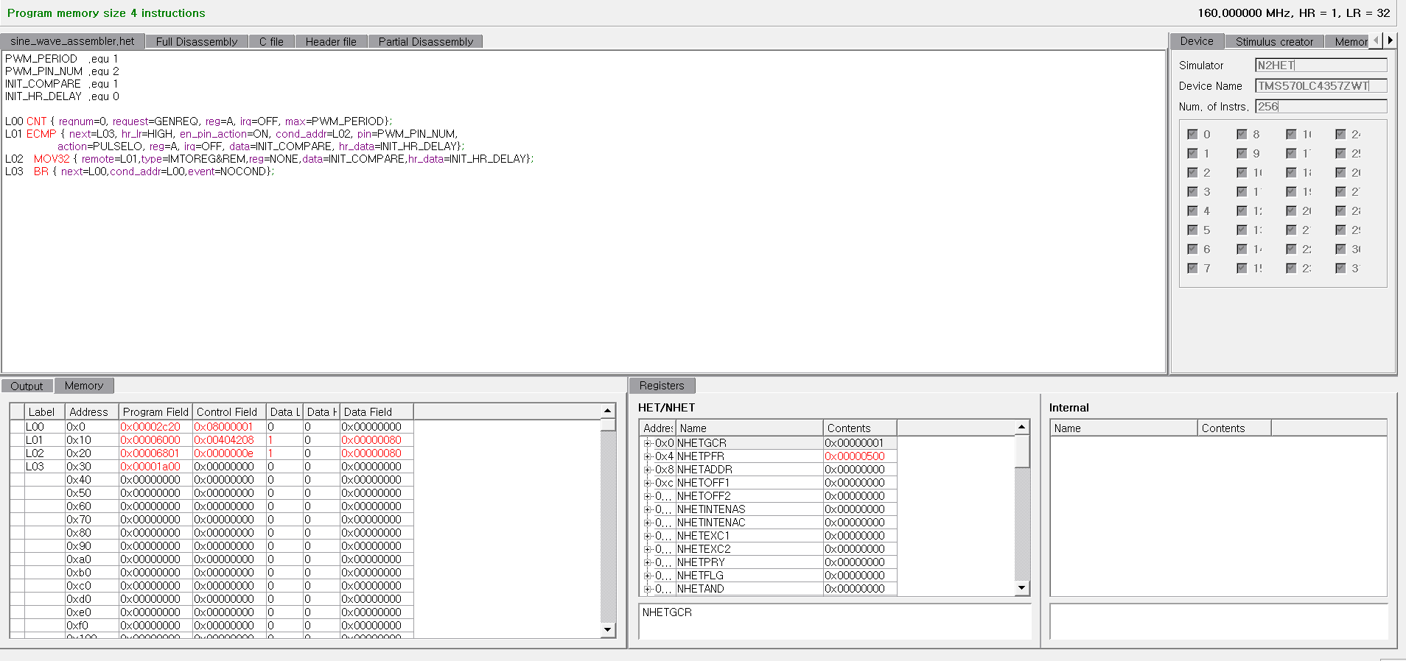
HET IDE
Ti에서 제공하는 HET 전용 assembler & Waveform IDE

Slide 25
2.5MHz
VCLK2
HR
prescaler
Loop resolution
prescaler
Loop resolution
clock
80MHz
1, 2, 3, … , 64
HR
Clock
1, 2, 4, 8,…, 32 , …,128
80MHz

Slide 26
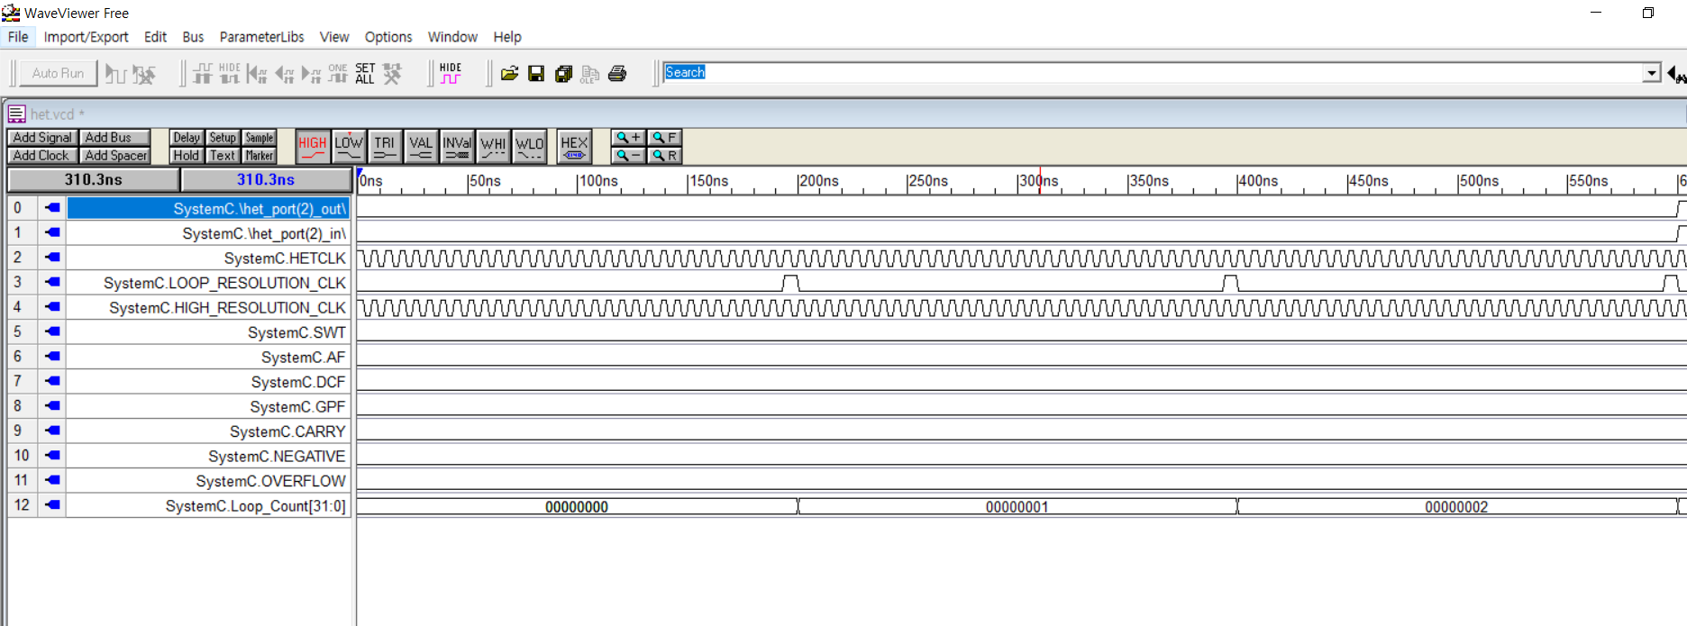

Slide 27
Instruction
PWM_PERIOD .equ 1
PWM_PIN_NUM .equ 2
INIT_COMPARE .equ 1
INIT_HR_DELAY .equ 0
L00 CNT { reqnum=0, request=GENREQ, reg=A, irq=OFF, max=PWM_PERIOD};
L01 ECMP { next=L03, hr_lr=HIGH, en_pin_action=ON, cond_addr=L02, pin=PWM_PIN_NUM,
action=PULSELO, reg=A, irq=OFF, data=INIT_COMPARE, hr_data=INIT_HR_DELAY};
L02 MOV32 { remote=L01, type=IMTOREG&REM, reg=NONE, data=INIT_COMPARE, hr_data=INIT_HR_DELAY};
L03 BR { next=L00, cond_addr=L00, event=NOCOND};

Slide 28

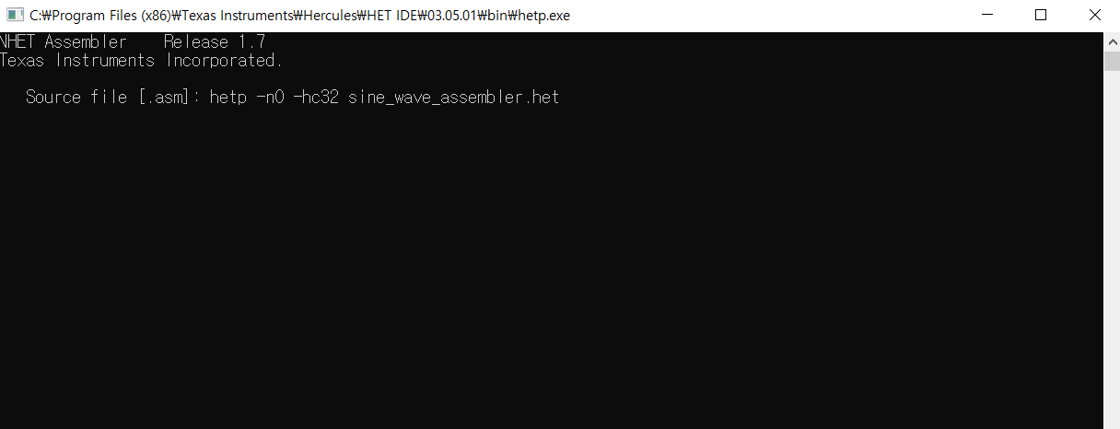
hetp -n0 -hc32 sine_wave_assembler.het

Slide 29
sine_wave_assembler.h
typedef union
{
HET_MEMORY Memory0_PST[4];
struct
{
CNT_INSTRUCTION L00_0;
ECMP_INSTRUCTION L01_0;
MOV32_INSTRUCTION L02_0;
BR_INSTRUCTION L03_0;
} Program0_ST;
} HETPROGRAM0_UN;
extern volatile HETPROGRAM0_UN e_HETPROGRAM0_UN;
extern const HET_MEMORY HET_INIT0_PST[4];
#endif
#define HET_v2 1
#define AID1_7
#include "std_nhet.h"
#define HET_L00_0 (e_HETPROGRAM0_UN.Program0_ST.L00_0)
#define pHET_L00_0 0
#define HET_L01_0 (e_HETPROGRAM0_UN.Program0_ST.L01_0)
#define pHET_L01_0 1
#define HET_L02_0 (e_HETPROGRAM0_UN.Program0_ST.L02_0)
#define pHET_L02_0 2
#define HET_L03_0 (e_HETPROGRAM0_UN.Program0_ST.L03_0)
#define pHET_L03_0 3

Slide 30
sine_wave_assembler.c
#include "std_nhet.h"
HET_MEMORY const HET_INIT0_PST[4] =
{
/* hetlabel_0_0 */
{
0x00002C20,
0x08000001,
0x00000000,
0x00000000
},
/* L01_0 */
{
0x00006000,
0x00404208,
0x00000080,
0x00000000
},
/* L02_0 */
{
0x00006801,
0x0000000E,
0x00000080,
0x00000000
},
/* L03_0 */
{
0x00001A00,
0x00000000,
0x00000000,
0x00000000
}
};

Slide 31
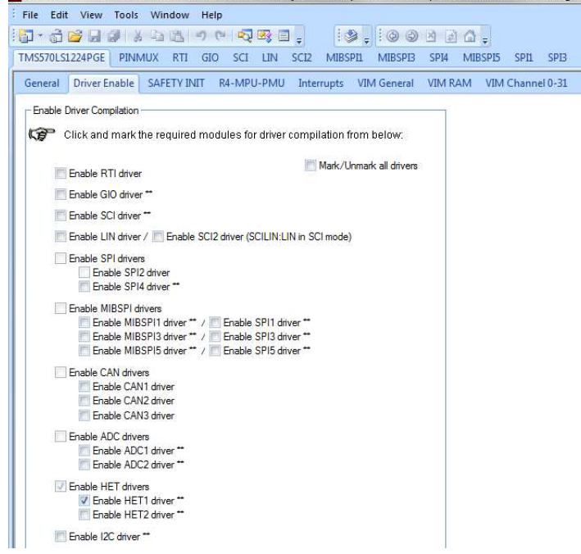
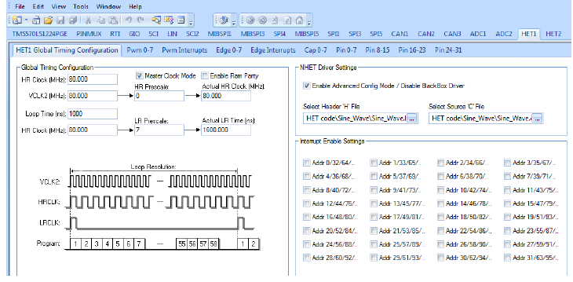
CCS

Slide 32
main
int main(void)
{
hetInit();
htuInit();
configNHET1();
while(1);
}

Slide 33
configNHET1()
void configNHET1()
{
hetREG1->PFR = LRPFC << 8;
calculate_ecmp_compare();
hetREG1->REQENS = 1;
hetREG1->DIR = (1 << NHET1_PIN_PWM) ;
hetRAM1->Instruction[pHET_L00_0].Control =
(uint32)(CNT_MAX_PERIOD - 1) |
(hetRAM1->Instruction[pHET_L00_0].Control & 0xFFFD0000);
hetRAM1->Instruction[pHET_L01_0].Control =
(hetRAM1->Instruction[pHET_L01_0].Control
& 0xFFFFE0FF) | (NHET1_PIN_PWM << 8);
}

Slide 34
Calculate_ecmp_compare()
void calculate_ecmp_compare()
{
int i = 0;
for(i=0; i<=SAMPLE_SIZE; i++)
{
sine_table[i] = (sine_table_percent[i] * (CNT_MAX_PERIOD << 7));
//sine_table_percent[SAMPLE_SIZE]
}
}

Slide 35
htuInit()
void htuInit()
{
htuDCP1 ->ITCOUNT = 0x00010000 + SAMPLE_SIZE;
htuDCP1 ->IHADDRCT = (htuDCP1 ->IHADDRCT & 0x0) |
0x1 << 23 | // DIR
0x0 << 22 | // SIZE
0x0 << 21 | // ADDMH
0x0 << 20 | // ADDFM
0x1 << 18 | // TMBA
0x0 << 16 | // TMBB
0x28 << 0; // IHADDR
htuDCP1 ->IFADDRA = (unsigned int)sine_table;
htuREG1 ->CPENA = 0x00000001;
htuREG1 ->GC = 0x00010000;
}

Slide 36
문제점 및 개선방안
파형 출력 안됨
Pin 체크를 안함
CCS에 het compiler 설정을 해야함
링크 https://www.element14.com/community/community/applications/industrial-automation-space/blog/2017/06/10/stepper-motor-control-with-hercules-high-end-timer-part-7-het-assembly-language-test
Sine_table[128] 데이터가 출력되는지 확인하기

Slide 37
향후 일정
회로와 펌웨어?
회로?
펌웨어?

Slide 38
Reference
http://www.ti.com/lit/an/spna217/spna217.pdf Sine Wave Generation Using PWM with Hercules N2het and HTU
http://www.ti.com/lit/an/spraba0b/spraba0b.pdf NHET Getting Started
http://www.ti.com/lit/ug/spnu490/spnu490.pdf Enhanced High-End Timer (NHET) Assembler User's Guide
http://www.ti.com/lit/ug/spnu485c/spnu485c.pdf HET IDE Tutorials
https://www.youtube.com/channel/UCJQkHVpk3A8bgDmPlJlOJOA Robert Feranec Youtube Channel
https://www.altium.com/documentation/16.1/display/ADES/Exploring+Altium+Designer Altium Documentations

